Slide 1
Disaster Tweet Classification Using NLP
Technologies: Python, TF‑IDF, Logistic Regression, Flask
Punam Sonawane

Slide 2
Problem Statement
The goal of this project is to classify whether a tweet is related to a disaster or not using Natural Language Processing and Machine Learning.

Slide 3
Project Objective
• Analyze Twitter text data
• Build a machine learning model to classify tweets
• Deploy the model using a Flask web application
• Allow users to input tweets and get predictions

Slide 4
Dataset Overview
Dataset: Twitter Disaster Dataset
Total Records: 7613
Columns: id, keyword, location, text, target
Target:
1 = Disaster Tweet,
0 = Non‑Disaster Tweet

Slide 5
Libraries Used
• pandas – data manipulation
• numpy – numerical operations
• matplotlib & seaborn – visualization
• scikit‑learn – machine learning
• flask – web application framework
• pickle – model saving

Slide 6
Loading the Dataset
Code:
df = pd.read_csv('C:\Users\HP\Downloads\twitter_disaster (1).csv')
Purpose:
Load the dataset into a pandas DataFrame for analysis.

Slide 7
Understanding the Dataset
Functions Used:
• df.shape
• df.info()
• df.describe()
Purpose:
To understand dataset size, structure, and statistical information.

Slide 8
Missing Value Analysis
Code:
df.isnull().sum()
Purpose:
Identify missing values in dataset columns.

Slide 9
Selecting Important Columns
Code:
df = df[['text','target']]
Purpose: Remove unnecessary columns and keep only the columns required for the NLP model.
text : Contains tweet content
target : Indicates whether the tweet is related to a disaster or not.

Slide 10
Exploratory Data Analysis (EDA)
EDA helps understand the distribution and patterns in
the dataset using graphs and visualizations.

Slide 11
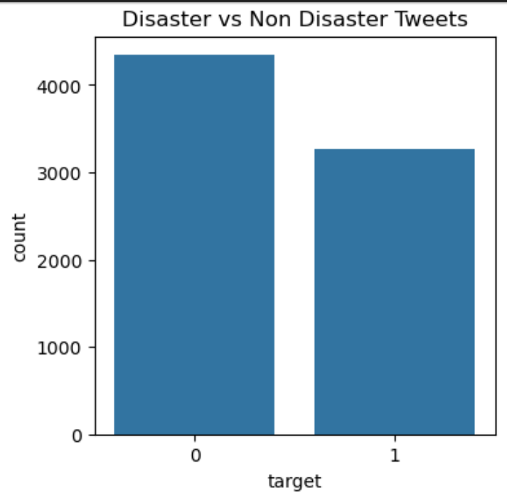
Target Distribution
Code:
sns.countplot(x='target', data=df)
Purpose:
Visualize the number of disaster
and non‑disaster tweets.
The graph shows the number
of tweets labeled as:
1 → Disaster Tweet 0 → Non Disaster Tweet

Slide 12
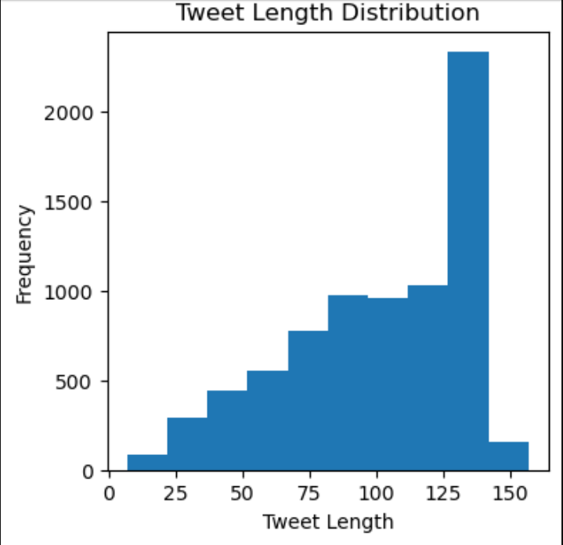
Tweet Length Analysis
Code:
df['length'] = df['text'].apply(len)
Purpose:
Analyze how tweet length varies
across the dataset.
The histogram shows how tweet
lengths are distributed in the
dataset. Most tweets fall within
a certain length range.

Slide 13
WordCloud Visualization
WordCloud is used to visualize the most frequent words appearing in tweets.
WordCloud for Non-Disaster Tweets
This visualization highlights the most frequently used words in tweets that are not related to disasters.
WordCloud for Disaster Tweets
This visualization highlights the most frequently used words in tweets related to disasters

Slide 14
Text Cleaning
Common preprocessing steps:
• Convert text to lowercase
• Remove URLs
• Remove special characters
• Remove unnecessary symbols
Purpose: In this step we clean the text to improve the performance of the machine learning model.

Slide 15
Feature Engineering –TF‑IDF
Code:
tfidf = TfidfVectorizer(max_features=5000)
Purpose:
TF-IDF converts textual data into numerical features so that machine learning models can understand the text.

Slide 16
Train Test Split
Code:
train_test_split(X, y, test_size=0.2)
Purpose:
Split data into training (80%) and testing (20%) datasets.

Slide 17
Model Training
Algorithm Used: Logistic Regression
Code:
model.fit(X_train, y_train)
Purpose:
Train a Logistic Regression model to classify tweets into disaster and non-disaster categories.

Slide 18
Model Evaluation
Evaluation Metrics:
• Accuracy Score
• Classification Report
• Confusion Matrix
Purpose:
Measure the performance of the trained model.

Slide 19
Model Serialization
Code:
pickle.dump(model, open('disaster_model.pkl','wb'))
Purpose:
Save the trained model and vectorizer so they can be reused in the web application.

Slide 20
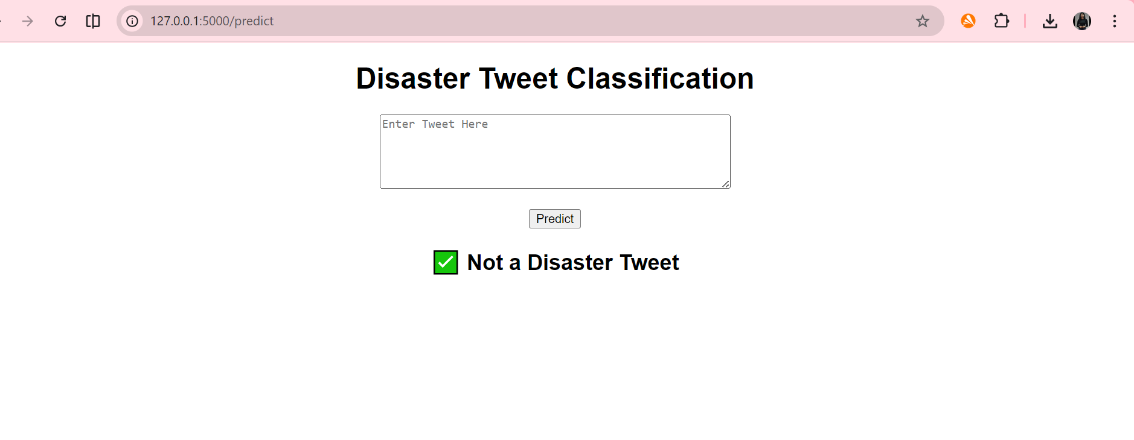
Flask Web Application
A Flask web application
was created where
users can enter a
tweet and the model
predicts whether it
is a disaster tweet or
not.
User Input → TF‑IDF Vectorizer → ML Model → Prediction Output

Slide 21
Conclusion
In this project we successfully developed a machine learning model that can classify tweets as disaster or non-disaster.
The model was trained using TF-IDF features and Logistic Regression algorithm.

